Slide 1
Face recognition
In Python
TEAM MEMBERS:
YU LUO
YANG ZHANG
YUHANG ZHANG
BO FAN

Slide 2
OPENCV
Video capture (grayscale)
Recognize Face (CascadeClassifier)
Revise picture (dataset)
64 X 64
label

Slide 3
CNN: convolution neural network
Model set
Tensorflow : Keras

Slide 4
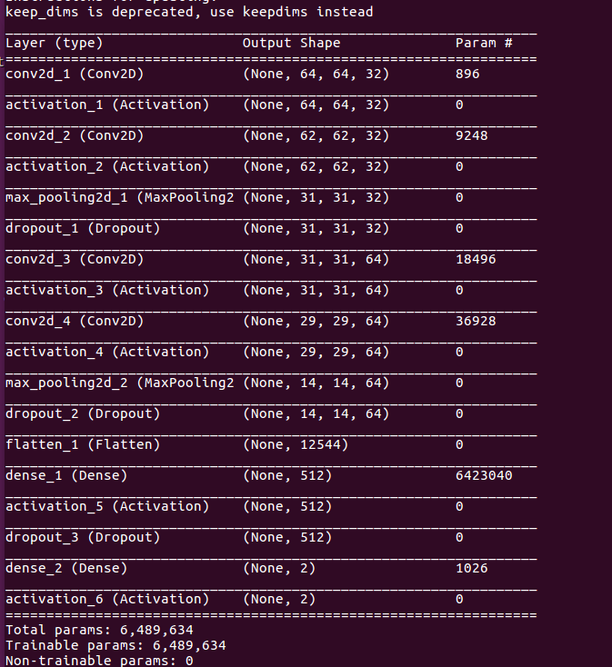
Initial model :
Parameters:
Convolution layers 4
Activation 5
Pooling layers 2
Dropout 3

Slide 5
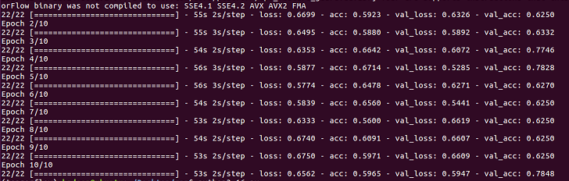
Result :
Through 10 times training
Training accuracy about 0.6
Test accuracy about 0.78

Slide 6
LET‘S SEE DEMO !

Slide 7
thank you！

